Slide 1
Website {
innovativeProject.html
presentation.css
[Foodstore Gwenny]
< Ashley Senaeve >
}
2023 - 2024

Slide 2
Table Of ‘Contents’ {
0
1
2
innovativeProject.html
presentation.css
Wat?
< Wat is het? >
Hoe?
< Hoe kom ik erbij? >
Technologieën
< Welke taal/framework? >
3
Roadmap/Planning
}
2023 - 2024

Slide 3
0 {
[Wat?]
innovativeProject.html
presentation.css
< Website voor automatenshop >
}
2023 - 2024

Slide 4

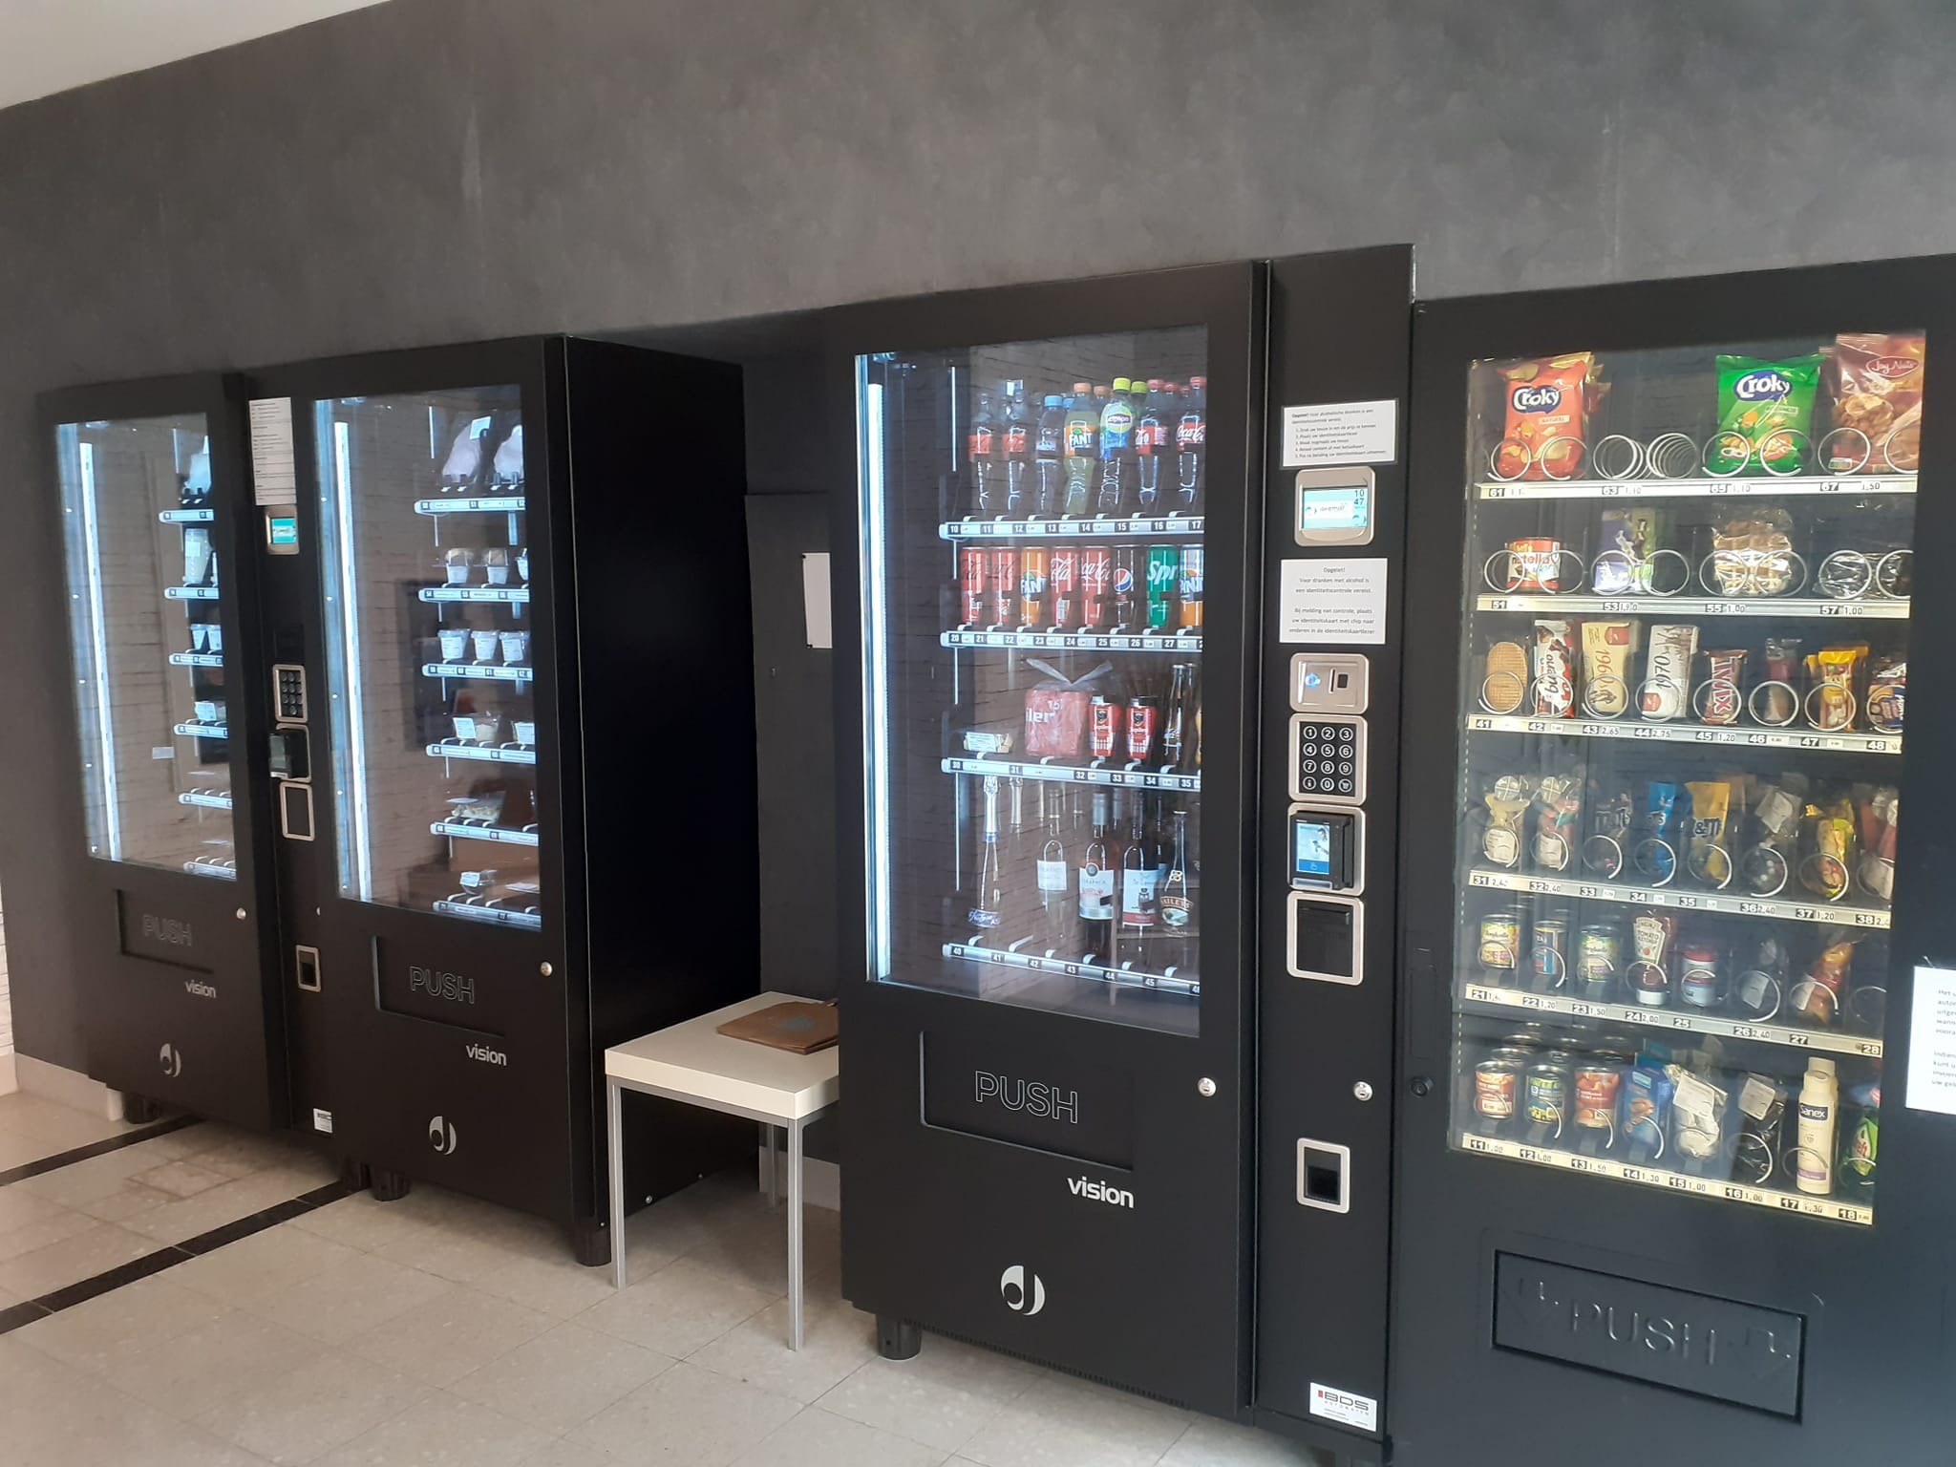
Foodstore Gwenny {
innovativeProject.html
presentation.css
Website voor ouders
}
2023 – 2024

Slide 5
1 {
[Hoe?]
innovativeProject.html
presentation.css
< Noodzaak >
}
2023 - 2024

Slide 6
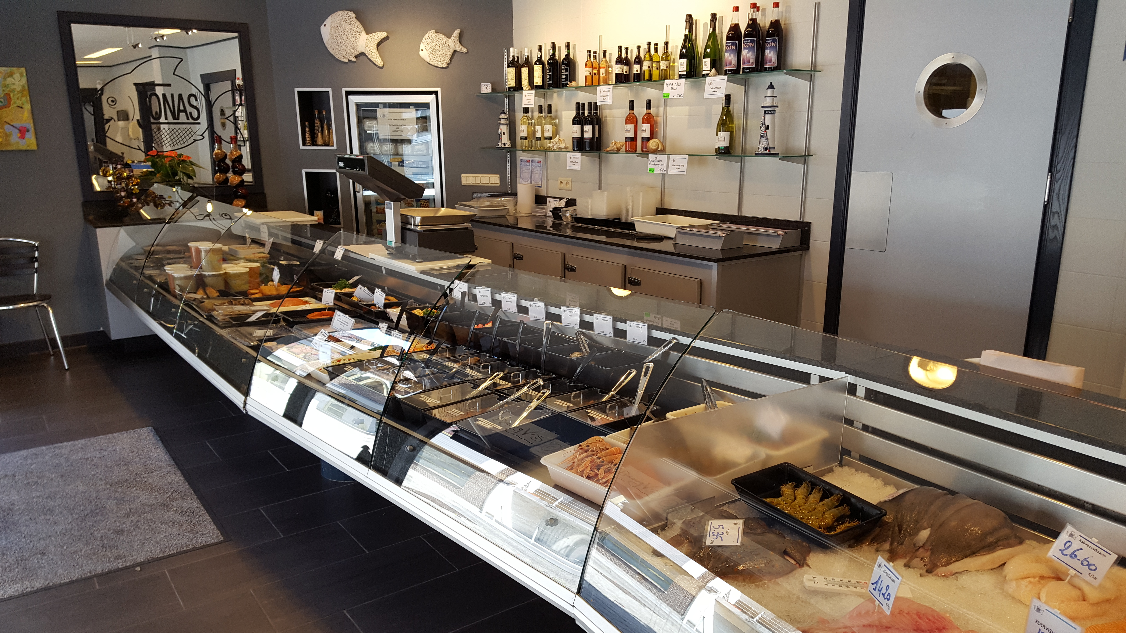
Noodzaak uitbreiding {
innovativeProject.html
presentation.css
Vishandel-Traiteur Jonas → Foodstore
}
2023 – 2024

Slide 7
2 {
[Technologieën]
innovativeProject.html
presentation.css
< Talen & frameworks >
}
2023 - 2024

Slide 8




Welke ‘technologieën’ gebruik ik? {
innovativeProject.html
presentation.css
Talen & frameworks
}
2023 - 2024

Slide 9
3 {
[Roadmap/Planning]
innovativeProject.html
presentation.css
}
2023 - 2024

Slide 10
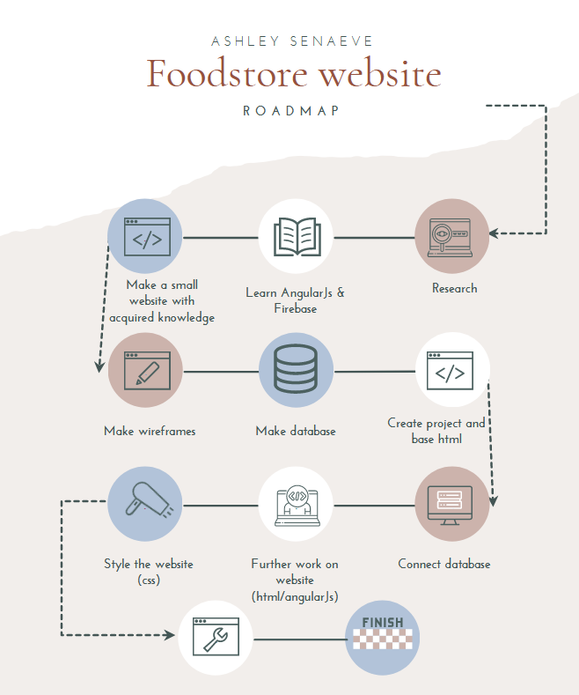
Roadmap & planning {
innovativeProject.html
presentation.css
Research
Learn
Demo
Start
Test
Fix
Finish
}
2023 – 2024

Slide 11
print(“Goodbye World!”) quit()
innovativeProject.html
presentationEnd.css
2023 - 2024

